Slide 1
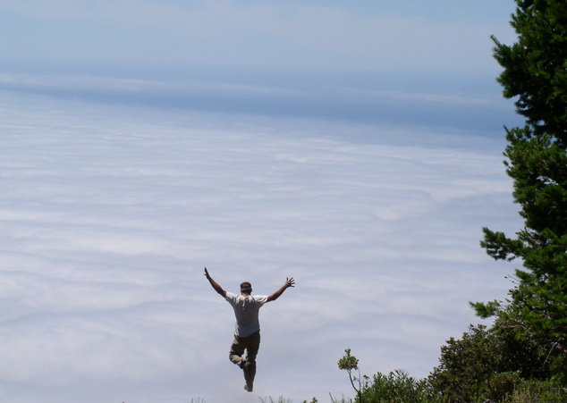
Global Environmental Issues
An overview of humanity’s effects on biodiversity change

Slide 2
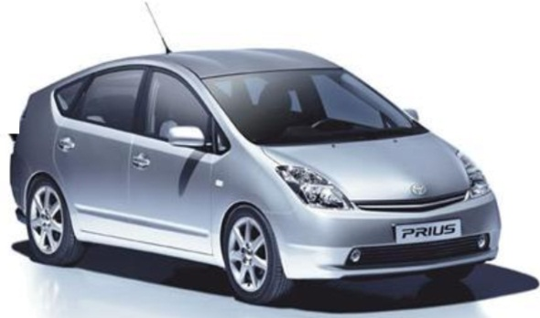
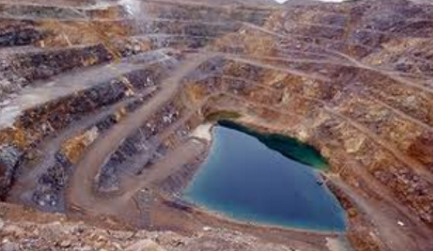
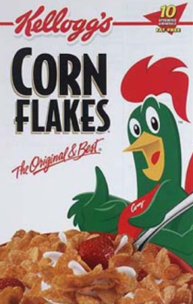
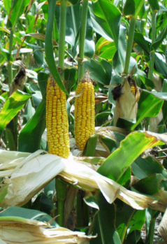
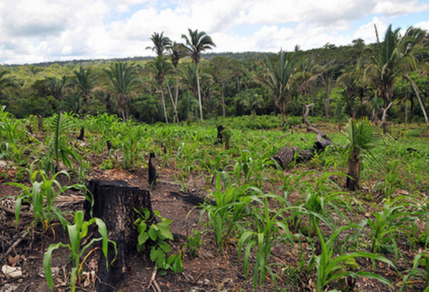
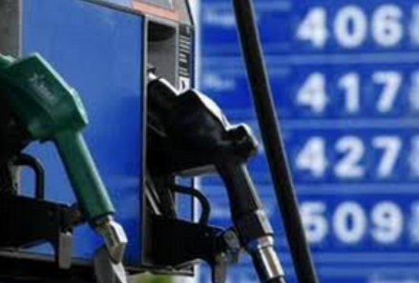

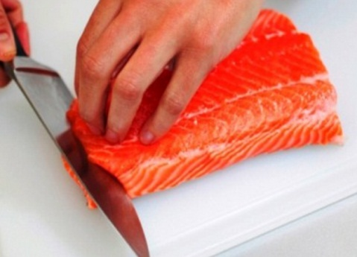
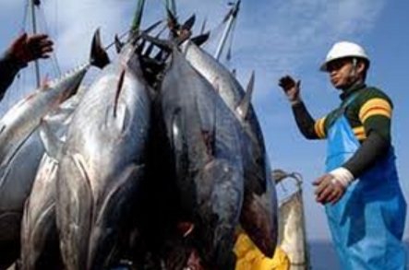
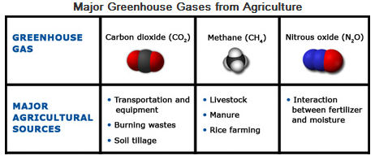
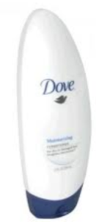
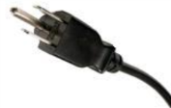
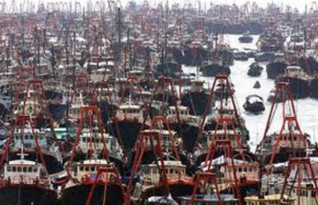
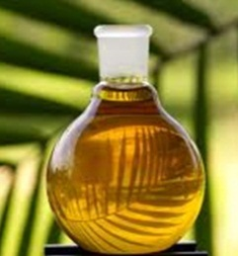
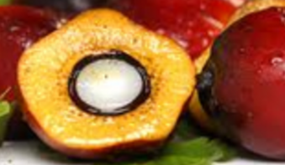
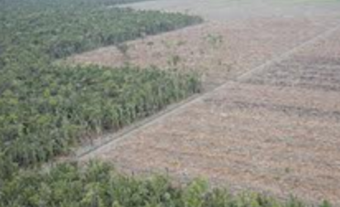
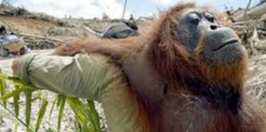
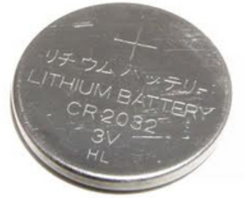
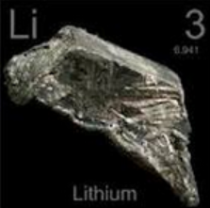
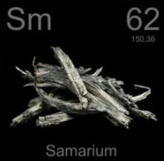
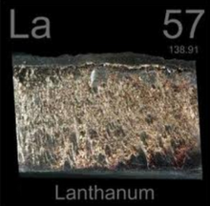
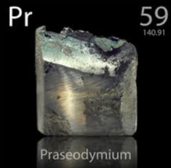
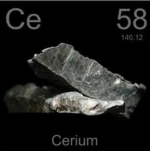
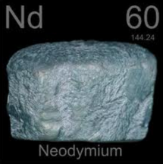
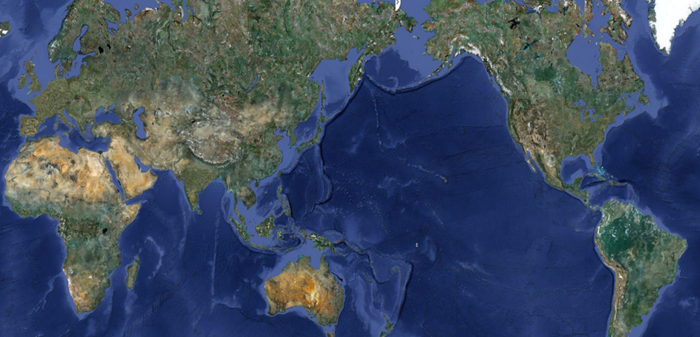
My environmental impact
Rare minerals
Breakfast
6:30am
Shower
7:30am
Driving
8:00am
Lunch
12:00pm
Watch TV
7:00pm
My day
Climate change
Habitat loss
Habitat loss
Climate change
Invasive species
Habitat loss
Invasive species
Invasive species
Climate change
Habitat loss
Invasive species
Climate change
Habitat loss
Habitat loss
Overexploitation
Overexploitation
Habitat loss
Overexploitation
Overexploitation
Habitat loss
Habitat loss
Notes:
By the end of my day my environmental impact is flashing like a Christmas tree.
Greenpeace has pushed for the cessation of PVC production as dioxin is created from the manufacture and incineration of the substance. Dioxin is one of the most deadliest of man-made poisons and it's a cumulative toxin, meaning it stays in the body for a long time, concentrating in food chains at the highest levels in carnivores - which includes us.
Substances called phthalates are added to PVC to make it flexible. Studies of animals show that some of these chemicals are may cause cancer, kidney and reproductive system damage. The disturbing part is that soft PVC is often used in toys for young children - and they just love putting things in their mouths. The phthalate issue is now such a concern, the U.S. Environmental Protection Agency (EPA) recently announced a series of actions.

Slide 3

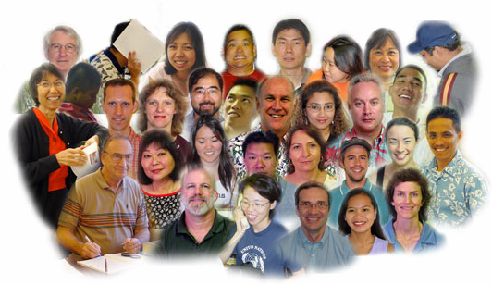
My average impact
7.8 billion people today
=
X
A HUGE PROBLEM
100% of the world’s oceans affected by human activities (Halpern et al. Science 2008)
83% of the world’s land affected by human activities (Sanderson et al. BioScience 2002)
6 million hectares of forest deforested annually (Global Biodiversity outlook 2)
Global mangroves declined from 18.8 million ha in 1980 to 15.2 million ha in 2000 (The world’s mangroves 2005)
Sea-grasses are disappearing at 110 km²/yr since 1980. Globally, up to 29% are gone (Waycott et al. PNAS 2009)
Large predatory fish declined by 90% since the 50’s (Myers & Worm, Nature 2003)
Some ~3000 monitored wild populations have declined by about 30% since 1970 (Living Planet Index 2010)
One third of the world’s corals are threatened with extinction (Carpenter et al., Science 2008)
Up to 48% of the world’s amphibians have declining populations (Stuart et al., Science 2004)
Populations of vertebrates had declined by an average of 30% in the past 40 years (Hoffmann et al., Science 2010)

Slide 4
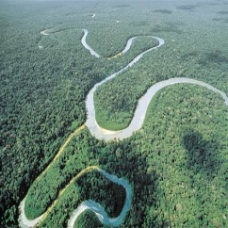
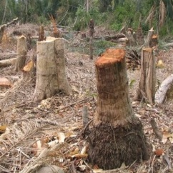
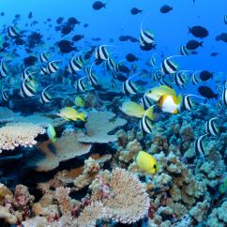
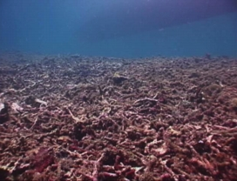
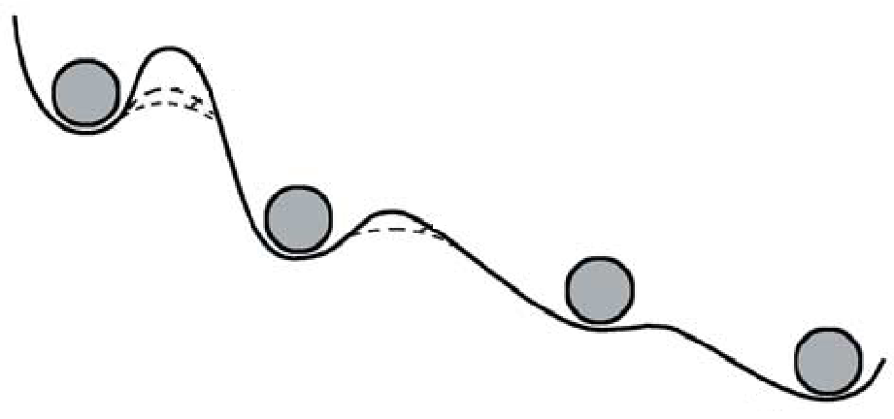
…changes may be irreversible…
Habitat loss
Overexploitation
Invasive species
Climate change
Some of the damages can be definitive
Alternative equilibrium states
Extinction vortex
Mal-Adaptations
Allee effect = low offspring
Low genetic diversity=low resilience
Habitat loss
Overexploitation
Climate change
Bellwood et al, Nature 2004
Creative Commons Photos by Neil Howard, Flickr
Notes:
We are not cutting any slag to these poor species and ecosystems
5:19min we end up with systems that cannot return to their original states even if the stressors are removed.
5:45min Even now in the first world the thing is turning scary. For instance in the US 50 million people are suffering hunger or at risk of it. In Countries from africa and asia and the southpacific the situation is truly scary.
6:30 min today about 1 billion people, 20% of the world’s human population live near environments that are so deteriorated that basic food supply to humanity is not ensured anymore. The situation is even more critical when you consider future scenarios of clean water supply.
7:05 min Those statisitics are just sad…how, we, as a developed and smart’ species are letting this to happen.

Slide 5
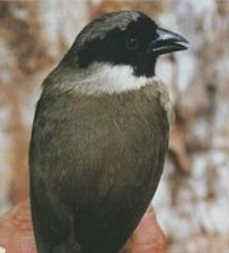
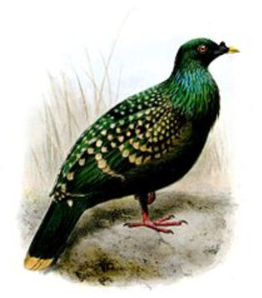
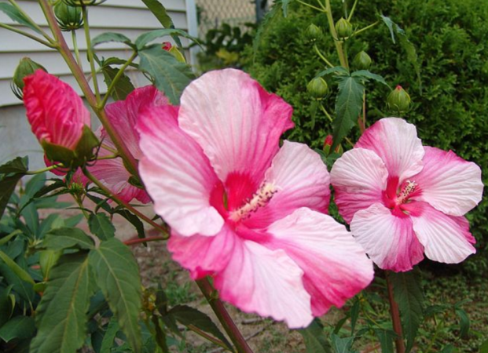
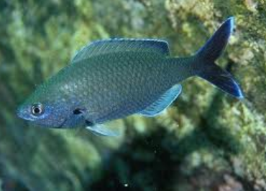
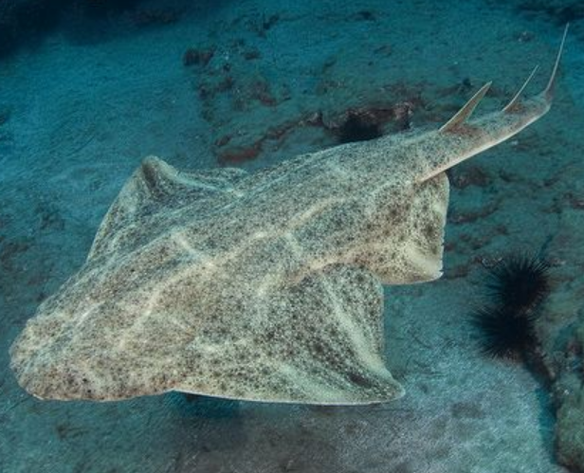
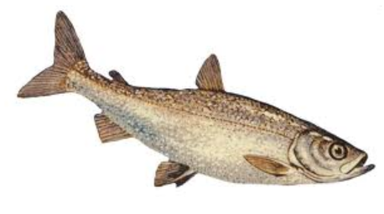
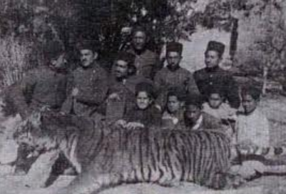
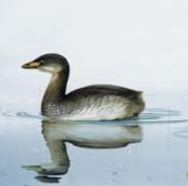
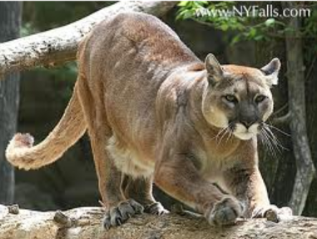
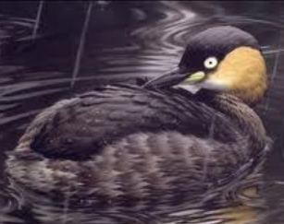
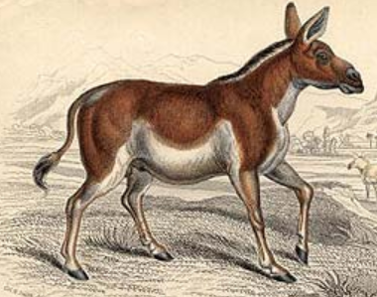
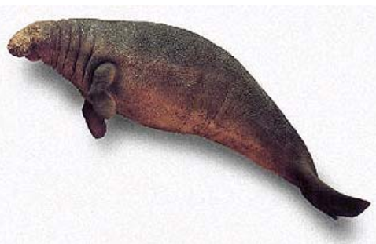
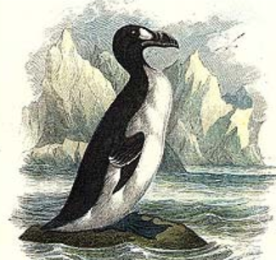
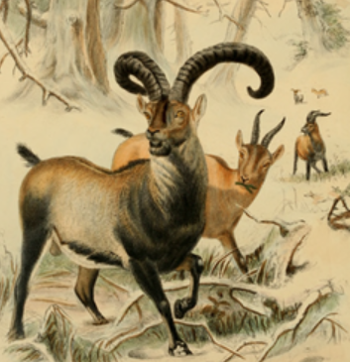
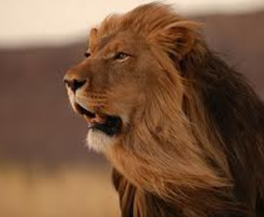
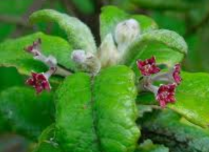
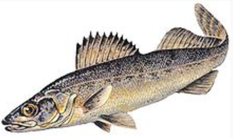
Few of those that paid the ultimate sacrifice and are not longer with us…
Puhielelu Hibiscadelphus
Hawaiian Honeycreeper
Black Spotted Damselfish
Liverpool Pigeon
Angel shark
Bezule
Caspian tiger
Atitlán Grebe
Eastern Cougar
Extinct 1981
Extinct 2004
Extinct 1970
Extinct 2008
Alaotra Grebe
Extinct 2011
Extinct 1930
The Quagga
Steller's Sea Cow
Great Auk
Pyrenean Ibex
Extinct 1970
St. Helena Olive
Extinct 1989
Cape Lion
Blue walleye
Extinct 2011
Extinct 2010
Extinct 1900s
Extinct 1741
Extinct 1840
Extinct 2000
Extinct 1963
Extinct 2003
Extinct 1983

Slide 6
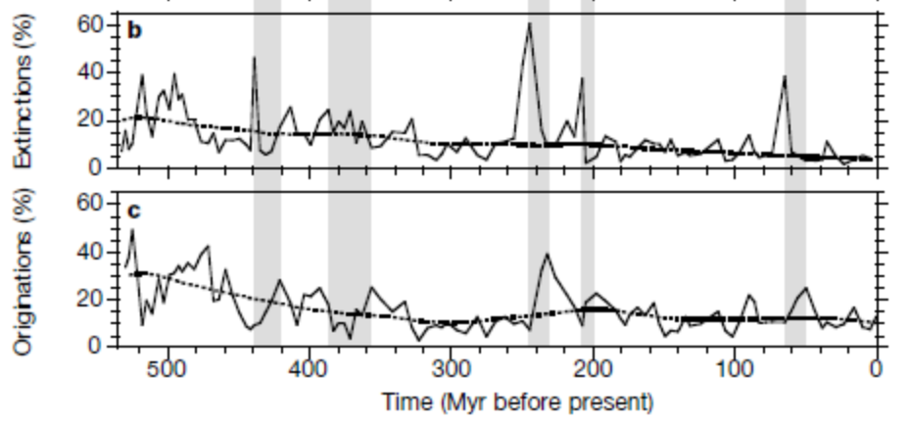
…changes may be forever…
end-Triassic
End-Ordovician
Cretaceous-Tertiary
Kirchner & Weil, Nature 2000
The historical record suggest that on average recovering from an extinction event takes up to 10 million years….
…so…
….today's anthropogenic extinctions will diminish biodiversity for millions of years to come (Kirchner & Weil, Nature 2000)

Slide 7
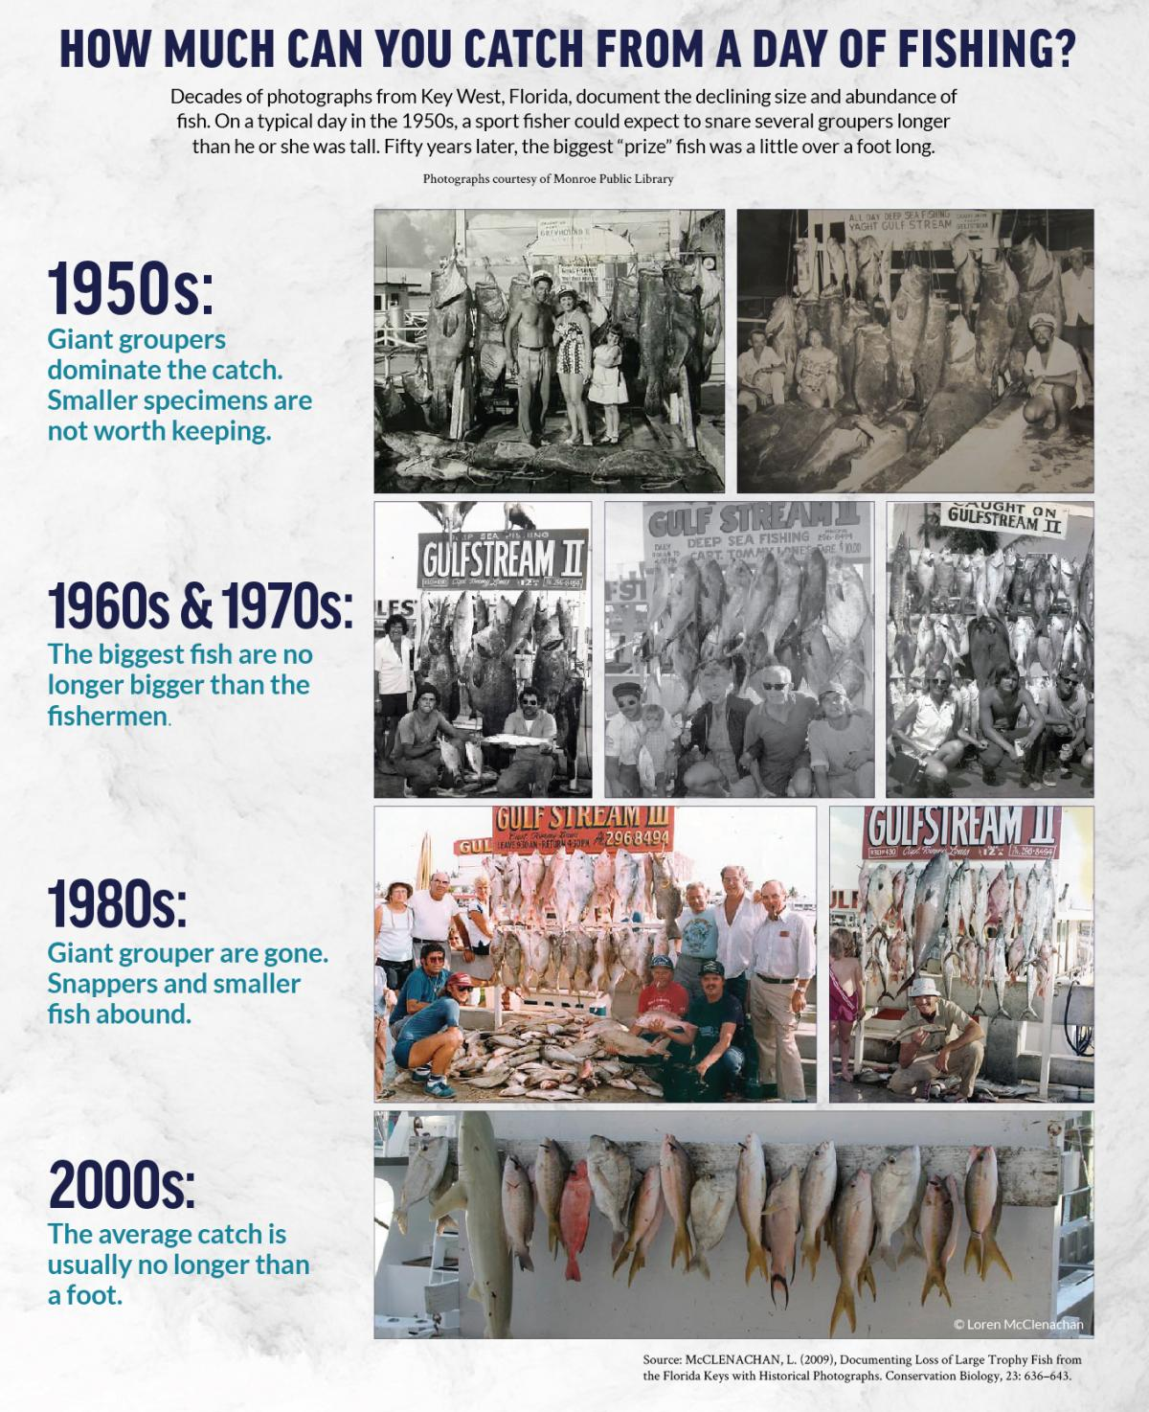
…we will lose interest in fixing the problem…
…shifting baseline syndrome…

Slide 8
…the nature of a problem gives you hints into the solution…
12 in Saudi Arabia
9 in the USA
0.68 in Haiti
Human suffering
2.1 ha/y
7,2 billion people today
X
In 2014
=
Earth’s biocapacity: 11 billion ha/y
1.3 Earth’s a year
Technology
→
Environmental impact
Mora & Sale, MEPS 2011
Mora, Ecology & Society 2014

Slide 9


The solutions:
For our generation will be the choice between a crowded planet or a better world
1. reduce natality
x 2.1 global hectares a year
/Earth’s biocapacity
One child per couple
Affordable/free family planning
Funding for women-led projects and GOOD education to capitalize on opportunities
Mora & Sale, MEPS 2011
Mora, Ecology & Society 2014

Slide 10
…ALSO…
…clean your own footprint…

Slide 11






MoraLab
The Carbon Neutrality Challenge
Your bads .
< Your goods
12.0
Your footprint on Earth is
7
0
Climate change
0
CO2 tons per year
5
0
Garbage

Slide 12


MoraLab
The Carbon Neutrality Challenge
Your bads .
< Your goods
12.0
Your footprint on Earth is
7
0
Climate change
0
CO2 tons per year
5
0
Garbage

Slide 13
MoraLab
The Carbon Neutrality Challenge
Your bads .
< Your goods
21.0
12.0
Your footprint on Earth is
Your footprint on Earth is
7
0
Climate change
CO2 tons per year
0
CO2 tons per year
5
0
5
Climate change
Habitat lost
1
2
1
Garbage

Slide 14

MoraLab
The Carbon Neutrality Challenge
Your bads .
< Your goods
21.0
24.0
Your footprint on Earth is
Your footprint on Earth is
7
0
Climate change
CO2 tons per year
0
CO2 tons per year
5
0
5
Climate change
Habitat lost
1
2
1
3
Garbage
Overexploitation

Slide 15

MoraLab
The Carbon Neutrality Challenge
Your bads .
< Your goods
25.0
24.0
Your footprint on Earth is
Your footprint on Earth is
7
0
Climate change
CO2 tons per year
0
CO2 tons per year
5
0
5
Climate change
Habitat lost
1
2
1
Overexploitation
3
Garbage
1

Slide 16






o
o
o
o
o
o
o
o
o
o
o
o
Glucose

Slide 17



How much CO2 do trees take?
Kou (1 ton)
Wiliwili (1 ton)
Koa (5 tonnes)

Slide 18



MoraLab
The Carbon Neutrality Challenge
Your bads .
< Your goods
25.0
Ohia
19.0
Your footprint on Earth is
Your footprint on Earth is
7
Koa
1
0
5
Climate change
CO2 tons per year
0
CO2 tons per year
5
0
5
Climate change
Habitat lost
1
2
1
Overexploitation
3
Garbage
1
Pollution

Slide 19
MoraLab
The Carbon Neutrality Challenge
Your bads .
< Your goods
19.0
Ohia
Your footprint on Earth is
7
Koa
1
0
5
0
Climate change
CO2 tons per year
5
0
5
Climate change
Habitat lost
1
2
1
3
Overexploitation
Garbage
1
Pollution

Slide 20
MoraLab
The Carbon Neutrality Challenge
Your bads .
< Your goods
16.0
Ohia
19.0
Your footprint on Earth is
Your footprint on Earth is
7
Koa
1
0
5
Climate change
CO2 tons per year
0
CO2 tons per year
5
Ohia
3
1
0
5
Climate change
Habitat lost
1
2
1
3
Overexploitation
Garbage
1
Pollution

Slide 21
MoraLab
The Carbon Neutrality Challenge
Your bads .
< Your goods
16.0
Ohia
13.0
Your footprint on Earth is
Your footprint on Earth is
7
Koa
1
0
5
Climate change
CO2 tons per year
0
CO2 tons per year
5
Ohia
3
1
0
Milo
3
1
5
Climate change
Habitat lost
1
2
1
3
Overexploitation
Garbage
1
Pollution

Slide 22
MoraLab
The Carbon Neutrality Challenge
Your bads .
< Your goods
13.0
Ohia
-2.0
Your footprint on Earth is
Your footprint on Earth is
7
Koa
1
0
5
Climate change
CO2 tons per year
0
CO2 tons per year
5
Ohia
3
1
0
Milo
Climate change
Habitat lost
3
1
Koa
3
5
5
1
2
1
3
Overexploitation
Garbage
1
Pollution

Slide 23
MoraLab
The Carbon Neutrality Challenge
Your bads .
< Your goods
-2.0
Ohia
Your footprint on Earth is
7
Koa
1
0
5
0
Climate change
CO2 tons per year
5
11
Ohia
3
1
0
Milo
trees
3
1
Koa
3
5
5
1
2
Climate change
Habitat lost
1
3
Overexploitation
Garbage
1
Pollution

Slide 24














Who will do the work?

Slide 25

Lanikai Elementary, Kailua, USA, 2016

Slide 26

Military School, Kailua, USA, 2016

Slide 27

4th Grade Lanikai School, Kailua, USA, 2016

Slide 28

Heco, Wai'anae, USA, 2017

Slide 29

Geography class, Wai'anae, USA, 2018

Slide 30

Liholiho Elementary, Wai'anae, USA, 2018

Slide 31

Evan’s group, Waimea, USA, 2018

Slide 32

Tom’s group, Na Pohaku, USA, 2018

Slide 33










Geography 309, 99 trees planted
20 teams at once
Ala Mahemoe, 2018
Mid-Pac, 47 trees planted
2018 Arrow of light, 46 trees planted
1,100 trees in two hours!
Punahou, 31 trees planted
St. Andrew’s, 20 trees planted
Mortar Board & Friends, 19 trees planted
DJ, 10 trees planted
UH Geography, 7 trees planted
Iolani, 2 trees planted
Resilience Regiment!, ? trees planted

Slide 34

St. Andrews
Punahou
Campbell
Seeds
Botany department
Math department
Hawaiian Airlines
Telcom
Alexander & Baldwin
United Churches
2,000signed up volunteers

Slide 35
180 teams at once
Gunstock Ranch, 2019
10,000 trees in two hours!
https://youtu.be/zLEcLHR8tsk

Slide 36
Our plan:
Trees planted
100
Last four years
, tens of events
1,000
November, 2018
10,000
December 7th, 2019
Covid-19
100,000
1,000,000

Slide 37

A very real environmental crisis
WE KNOW
Problem
Solution
“We are all born ignorant, but one must work hard to remain stupid”
Benjamin Franklin

